Slide 1
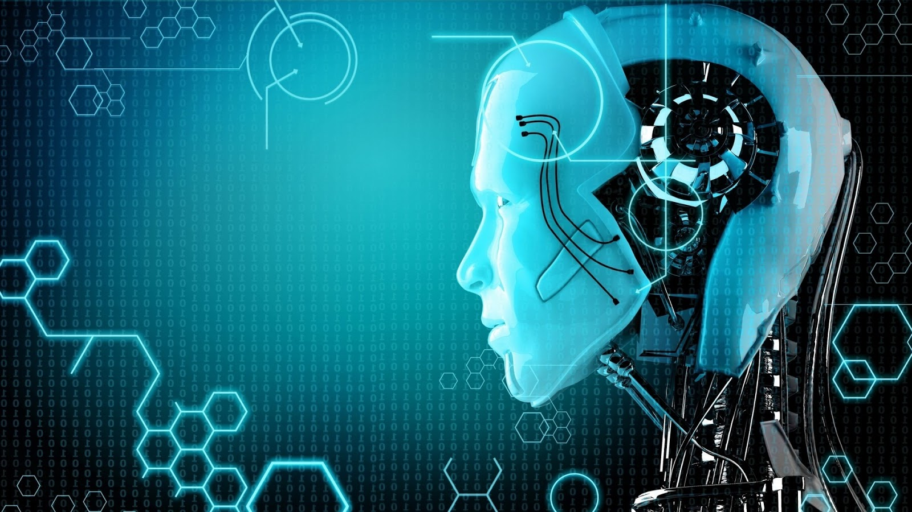
Artificial Intelligence
Department of ECE
Presented By
Sumith Babu(17H61A04D1)

Slide 2

Table of Contents
Introduction
Definition
Applications of AI
Advantages and Disadvantages
Growth and Future of AI
Conclusion

Slide 3
The Birthplace of “Artificial Intelligence”, 1956
Darmouth workshop, 1956: historical meeting of the precieved founders of AI met: John McCarthy, Marvin Minsky, Alan Newell, and Herbert Simon.
A Proposal for the Dartmouth Summer Research Project on Artificial Intelligence. J. McCarthy, M. L. Minsky, N. Rochester, and C.E. Shannon. August 31, 1955. "We propose that a 2 month, 10 man study of artificial intelligence be carried out during the summer of 1956 at Dartmouth College in Hanover, New Hampshire. The study is to proceed on the basis of the conjecture that every aspect of learning or any other feature of intelligence can in principle be so precisely described that a machine can be made to simulate it." And this marks the debut of the term "artificial intelligence.“
50 anniversery of Darmouth workshop

Slide 4
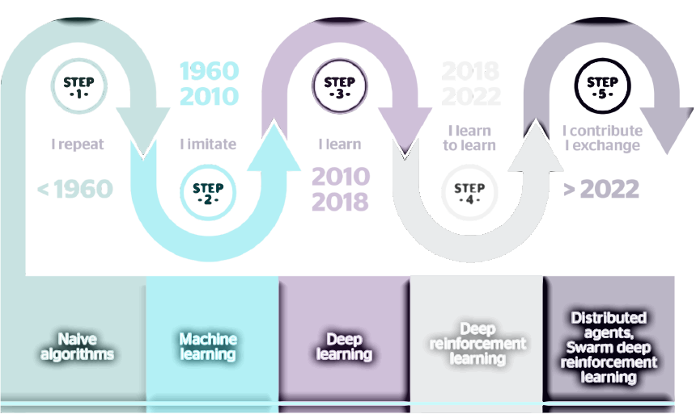

Slide 5

Introduction
Intelligence : “The capacity to learn and solve problems.”
Artificial Intelligence : Artificial Intelligence (AI) is the simulation of
human intelligence by machines.
The ability to solve problems.
The ability to act rationally.
The ability to act like humans.
The central principles of Al include :
Reasoning, knowledge, planning, learning and communication.
Perception and the ability to move and manipulate objects.
It is the science and engineering of making intelligent machines, especially intelligent computer programs

Slide 6

Computers with the ability to mimic or duplicate the functions of the human brain.
Artificial Intelligence is the intelligence of machines and the branch of computer science which aims to create it.
"The branch of computer science that is concerned with the automation of intelligent behaviour" (Luger and Stubblefield. 1993).

Slide 7
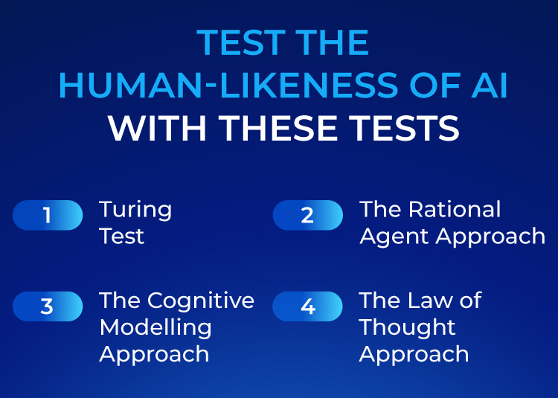
How do we measure ?

Slide 8
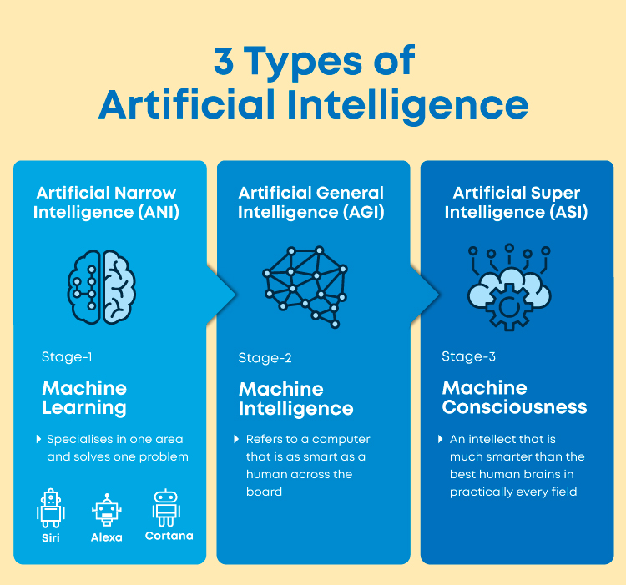

Slide 9
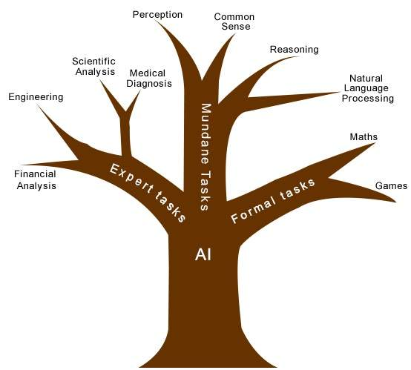
Research areas in AI

Slide 10


Application of AI in Medicine
A medical clinic can use AI systems to organize bed schedules, make a staff rotation and provide medical information.
AI has also application in fields of cardiology (CRG), neurology (MRI), embryology (sonography), complex operations of internal organs, etc
It also has an application in Image guided surgery and image analysis and enhancement.

Slide 11
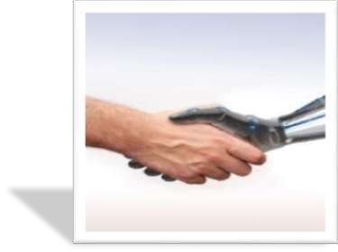
Application of AI in Telecommunications
Many telecommunications companies make use of heuristic search in the management of their workforces.
For example BT Group has deployed heuristic search in a scheduling application that provides the work schedules of 20000 engineers.

Slide 12

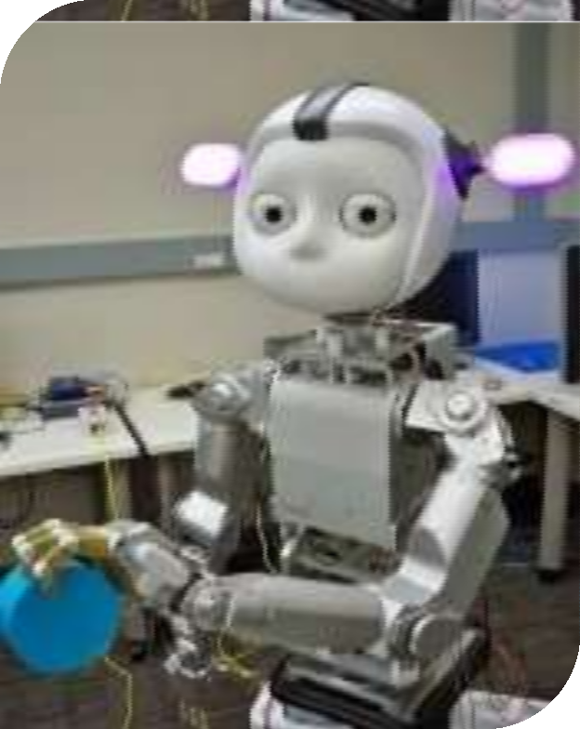
Robotics and AI
A ROBOT is a mechanical or virtual artificial agent, usually an electro mechanical machine that is guided by a computer program or electronic circuitry.
Robots can be autonomous or
semi-autonomous.
A robot may convey a sense of intelligence or thoughts of its own.

Slide 13
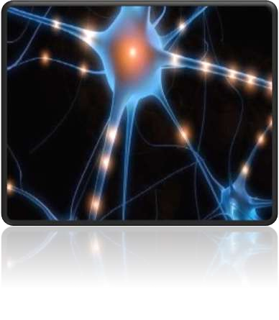
Some other Applications:
Credit granting
Information management and retrieval
AI and expert systems embedded in products
Plant layout
Help desk and assistance
Employee performance evaluation
Shipping
Marketing
Warehouse optimization
In space workstation maintainance
Satellite controls
Network developments
Nuclear management

Slide 14
 Advantages :
 Disadvantages :
More powerful and more useful computers.
New and improved interfaces.
Solving new problems.
Better handling of information.
Relieves information overload.
Conversion of information into knowledge.
Increased costs
Difficulty with software development - slow and expensive
Few experienced
programmers
Few practical products have reached the market as yet.

Slide 15
State of the art
Deep Blue defeated the reigning world chess champion Garry Kasparov in 1997
Proved a mathematical conjecture (Robbins conjecture) unsolved for decades
No hands across America (driving autonomously 98% of the time from Pittsburgh to San Diego)
During the 1991 Gulf War, US forces deployed an AI logistics planning and scheduling program that involved up to 50,000 vehicles, cargo, and people
NASA's on-board autonomous planning program controlled the scheduling of operations for a spacecraft
Proverb solves crossword puzzles better than most humans
DARPA grand challenge 2003-2005, Robocup.
Bixby is an open artificial intelligence platform for assisting the human for any minor works in mobile.
SIRI and Alexa are similar Ai based voice assistants used in Apple mobiles and Amazon.
Tesla is a company to include AI in self driving vechiles

Slide 16
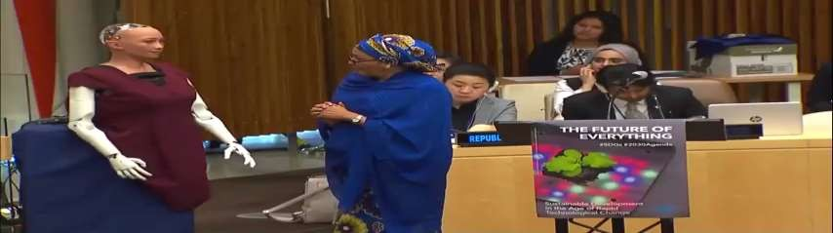
Humanoid Robot and AI
Sophia is a social humanoid robot developed by Hong Kong based company Hanson Robotics.
Sophia was activated on April 19,2015.
She made her first public appearance at South by Southwest Festival in mid-March 2016 in United States.
In October 2017 Sophia became a Saudi Arabian citizen, the first robot to receive citizenship in any country.

Slide 17
Future Of AI
Looking at the features and its wide application we may definitely stick to artificial intelligence. Seeing at the development of Al is it that the future world is becoming artificial.
Biological intelligence is fixed, because it is an old, mature paradigm but the new paradigm of non-biological computation and intelligence is growing exponentially.
The memory capacity of the human brain is probably of the order often thousand million binary digits. But most of this is probably used in remembering visual impressions, and other comparatively wasteful ways.
Hence we can say that as natural intelligence is limited and volatile too
world may now depend upon computers for smooth working.

Slide 18
Conclusion
Till now we have discussed in brief about Artificial Intelligence.
We have discussed some of its principles, its applications, its achievements etc.
The ultimate goal of institutions and scientists working on Al is to solve majority of the problems or to achieve the tasks which we humans directly can't accomplish.
It is for sure that development in this field of computer science will change the complete scenario of the world. Now it is the responsibility of creamy layer of engineers to develop this field.

Slide 19



Slide 20
Thank You

